Slide 1

LISTENING MODULE A
FUNCTIONS:
Listening for details.
Listening to people describing the effects of technology in their work.
Listening to a description of places.

Slide 2


Listening 1
Listen to a conversation between a DataPro Inc employee and her supervisor. Choose the correct answers:
What is the dialogue about?
Asking for a raise.
Requesting a transfer.
Assuring product quality.
Improving hardware.
What can you infer about the employee?
She does not like her new section.
She has experience with hardware.
She does not understand the changes.
She creates valuable software.

Slide 3
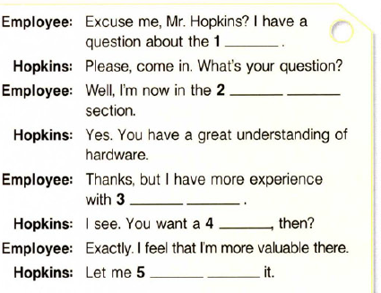
Listen again and complete the conversation.

Slide 4
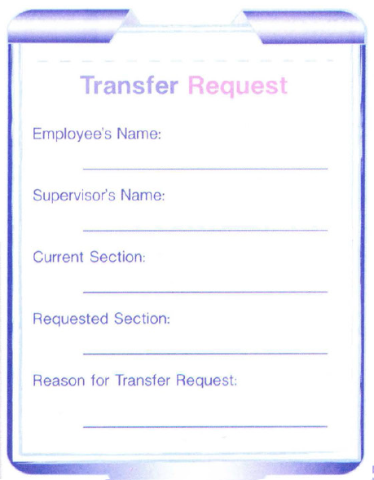
Now try to fill in the transfer request.

Slide 5

Listening 2
Comparative and superlative forms: Video.
http://www.real-english.com/reo/39/unit39.asp#

Slide 6

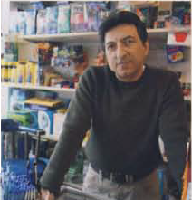


Listening 3
Listen to four people describing the effects of new technology on their work. Match each person to his / her job.
1 2 3 4
a. Shop owner …… b. Doctor ……. c. Musician ……. d. Teacher…....

Slide 7
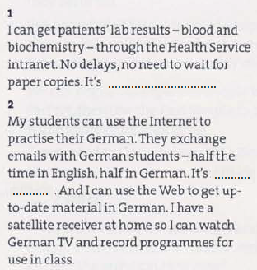
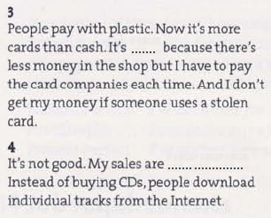
Listen to the four people again and complete with the phrases below each blank.
a. more realistic b. much faster c. safer d. much worse

Slide 8
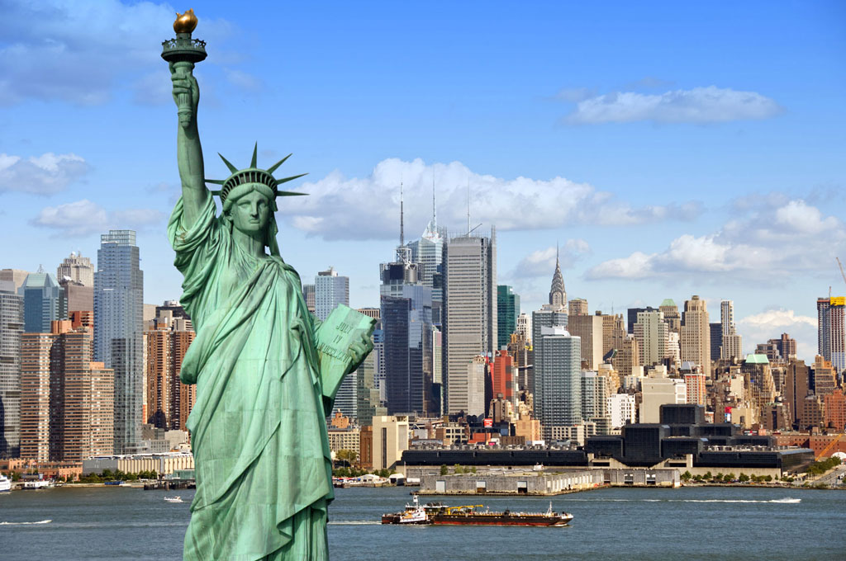
Listening 4
In which city is the Statue of Liberty?
a. In Los Angeles. b,. In Washington D.C. c. In New York City. d. In San Francisco.
2) Fill in the blanks.
The Statue of Liberty is one of the most recognizable …………… of the United States, representing …………… and …………… from …………… people all around the world. The Statue of Liberty was for decades often the first …………… of the United states for millions of ……………arriving after ocean voyages from …………… .
3) When was the Statue of Liberty dedicated? What was the occasion?
The statue of Liberty was dedicated on ……………………. to commemorate the ……………….. of the founding of the United States.
4) Which country gave the Statue of Liberty as a gift / present? a. England. b. Germany. c. France. d. Italy.
5) Choose the correct answers.
Fredéric Auguste Bartholdi… a. Engineered the internal structure. b. Sculpted the statue.
Gustave Eiffel… a. Engineered the internal structure. b. Sculpted the statue.
6) How much did the Statue of Liberty cost? a. $2,500. b. 25,000. c. 250,000. 2,500,000
7) Which means of transport do you have to take to see the Statue of Liberty? a. A bus. b. A ferry. c. A plane.

Slide 9
8) Complete the following description of the Statue of Liberty?
The statue is of a …………… figure standing upright, dressed in a …………… with a ……………point spiked rays representing a ……………, holding a stone …………… close to her body in her ……………. hand and a flaming …………… high in her …………… hand. The tablet bears the date ……………, commemorating the date of the United States …………… of …………… .
9) What is the Statue of Liberty composed of?
The Statue of Liberty is made of a sheeting of pure …………… hung on a framework of …………… with the exception of the flame of the torch, which is coated in …………… leaf.
10) What are the characteristics of the pedestal on which the Statue of Liberty stands?
The statue stands atop a rectangular stonework pedestal with a foundation in the shape of an irregular ……………………. –pointed ……………….. .
11) How tall is the Statue of Liberty? a. 151 feet 1 inch tall. b. 151 feet 10 inch tall. c. 153 feet 1 inch tall.
12) New York is the biggest city in the United States. a. True. b. False.
13) How many inhabitants are there in New York City? a. over 5 million. b. over 8 million. c. over 10 million.

Slide 10
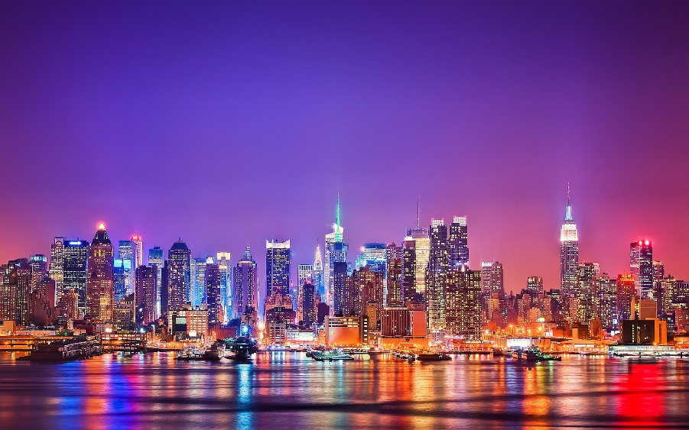
14) How many foreign and American tourists visit New York City each year?
a. about 20 million. b. about 30 million. c. about 40 million.
15) Fill in the blanks in the description of New York City.
The city's …………… centers for …………… are among the nation's most influential, and for more than a century, it's been one of the world's major centers of …………… and ……………
.

